Slide 1
Introduction to Data Analysis

Slide 2
STATISTICAL LEARNING
Patrick Boily Data Action Lab | uOttawa | Idlewyld Analytics
[with files from Jen Schellinck | Sysabee]

Slide 3
“Data science does not replace statistical modeling and data analysis; it augments them.”
(P. Boily)

Slide 4
LEARNING CONTEXT
STATISTICAL LEARNING
“We learn from failure, not from success!”
(Bram Stoker, Dracula)

Slide 5
WHAT IS DATA SCIENCE? (REPRISE)
Data Science (DS) is the collection of processes by which we extract useful and actionable insights from data.
(paraphrased from T. Kwartler)
DS is the working intersection of statistics, engineering, computer science, domain expertise, and “hacking.” It involves two main thrusts: analytics (counting things) and inventing new techniques to draw insights from data.
(paraphrased from H. Mason)
Data science is about asking the right questions and accepting imaginative solutions; in the battle between “tried, tested, and true” and “disruptive data science”, with whom do you side?
(P. Boily)

Slide 6
THE MINING ANALOGY
What are we mining? data (earth)
What are we using to mine? data mining techniques (digging tools)
What are we mining for? looking for patterns/knowledge (raw minerals)
What do we do with the raw material? describe patterns/relationships (refine minerals into something useful)
What is the output, or product? models (Ge, Ga, Si to build transistors)
What do we do with the product? apply models to evidence-based decision support (use transistor in electrical systems)

Slide 7
LEARNING IN GENERAL
Beyond “just taking a quick look,” humans learn through:
answering questions
testing hypotheses
creating concepts
making predictions
creating categories and classifying objects
grouping objects
The central Data Science/Machine Learning problem is:
can (should) we design algorithms that can learn?

Slide 8
TYPES OF LEARNING
Supervised Learning (learning with a teacher)
classification, regression, rankings, recommendations
uses labeled training data (student gives an answer to each test question based on what they learned from worked-out examples)
performance is evaluated using testing data (teacher provides the correct answers)
Unsupervised Learning (grouping similar exercises together as a study aid)
clustering, association rules discovery, link profiling, anomaly detection
uses unlabeled observations (teacher is not involved)
accuracy cannot be evaluated (students might not end up with the same groupings)

Slide 9
TYPES OF LEARNING
Semi-Supervised Learning (teacher providing worked-out examples and a list of unsolved problems)
Reinforcement Learning (embarking on a Ph.D. with an advisor?)
_____________________________
In supervised learning, there’s a target against which to train the model. In unsupervised learning, we don’t know what the target is, or if there is one.
The distinction is crucial.

Slide 10
EXAMPLES
Deciding whether to issue a loan to an applicant based on demographic and financial data (with reference to a database of similar data on prior customers) is a supervised learning task.
Making recommendations to customers concerning additional items to buy based on the buying pattern in their prior transactions (and prior transactions of other customers) is an unsupervised learning task.

Slide 11
Association Rules
STATISTICAL LEARNING
MR. SNIFF: What are you looking for? MR. SNOOP: A five-dollar bill. MR. SNIFF: Are you sure you lost it on this street? MR. SNOOP: Oh no! I lost it in the next block, but I’m lookin’ up here because the light is better.
(Boys’ Life Magazine, 1932)

Slide 12
MOTIVATING EXAMPLE
The Danish National Patient Registry contains 68 million health observations on 6.2 million patients over a 15 year time span (‘96 –‘10).
Objectives:
finding connections between different diagnoses
determining how a diagnosis at some point in time might allow for the prediction of another diagnosis at a later point in time
Temporal disease trajectories condensed from population-wide registry data covering 6.2 million patients, Jensen, A.B., Moseley, P.L., Oprea, T.I., Ellesøe, S.G., Eriksson, R., Schmock, H., Jensen, P.B., Jensen, L.J., Brunak, S. [2014], Nature Communications.

Slide 13
METHODOLOGY
Compute strength of correlation for pairs of diagnoses over a 5 year interval on a representative subset of the data
Test diagnoses pairs for directionality (one diagnosis repeatedly occurring before the other)
Determine reasonable diagnosis trajectories (thoroughfares) by combining smaller frequent trajectories with overlapping diagnoses
Validate the trajectories by comparison with non-Danish data
Cluster the thoroughfares to identify central medical conditions (key diagnoses) around which disease progression is organized

Slide 14
RESULTS
Data was reduced to 1,171 thoroughfares on the course of
diabetes
chronic obstructive pulmonary disease (COPD)
cancer
arthritis
cardiovascular disease.
The data analysis showed, for example:
diagnoses of anemia followed later by the discovery of colon cancer
gout was identified as a step toward cardiovascular disease.
COPD is under-diagnosed and under-treated.

Slide 15
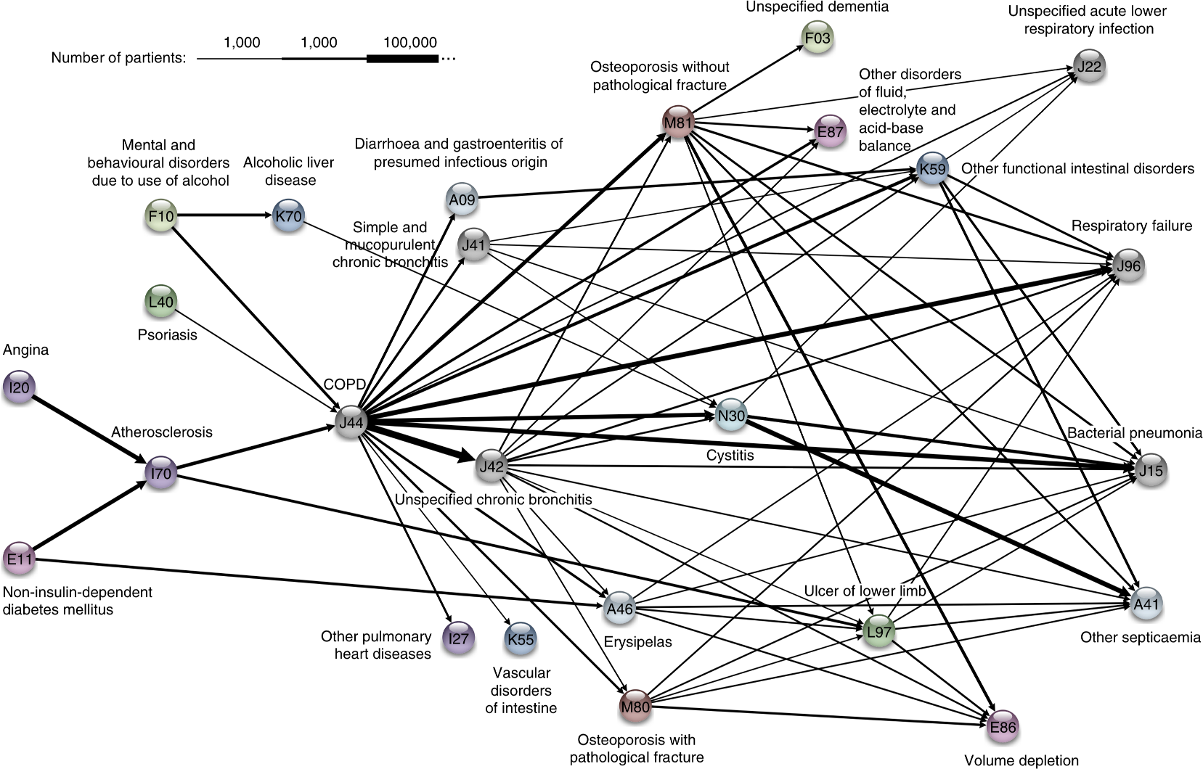
1,000 10,000 100,000

Slide 16
TAKE-AWAYS
Data makes it possible to view diseases in a larger context, which could yield tangible health benefits beyond one-size-fits-all medicine.
The sooner a health risk pattern is identified, the better we can prevent and treat critical diseases.
Instead of looking at each disease in isolation, you can talk about a complex system with many different interacting factors.
The order in which different diseases appear can help find patterns and complex correlations outlining the direction for each individual person.

Slide 17
ASSOCIATION RULES BASICS
Association Rule Discovery is a type of unsupervised learning that finds connections among attributes (and combinations of attributes).
Example: we might analyze a dataset on the physical activities and purchasing habits of North Americans and discover that
runners who are also triathletes (the premise) tend to drive Subarus, drink microbrews, and use smartphones (the conclusion), or
individuals who have purchased home gym equipment are unlikely to be using it 1 year later (to name some fictitious possibilities)

Slide 18
ORIGINAL APPLICATION
Supermarkets record the contents of shopping carts at check-outs to determine items which are frequently purchased together.
Examples:
bread and milk are often purchased together, but that’s not so interesting given how often they are purchased individually
hot dogs and mustard are also often purchased as a pair, but more rarely purchased individually
A supermarket could then have a sale on hot dogs to drive in customers, while raising the price on condiments, to drive in sales.

Slide 19
APPLICATIONS
Related Concepts
looking for pairs (triplets, etc) of words that represent a joint concept
{Ottawa, Senators}, {Michelle, Obama}, {veni, vidi, vici}, etc.
Plagiarism
looking for sentences that appear in various documents
looking for documents that share sentences
Bio-markers
diseases that are frequently associated with a set of bio-markers

Slide 20
APPLICATIONS
Making predictions and decisions based on these rules.
Alter circumstances or environment to take advantage of these correlations (often mis-used).
Use the connections to modify the likelihood of certain outcomes.
Imputing missing data.
Text autofill and autocorrect.

Slide 21
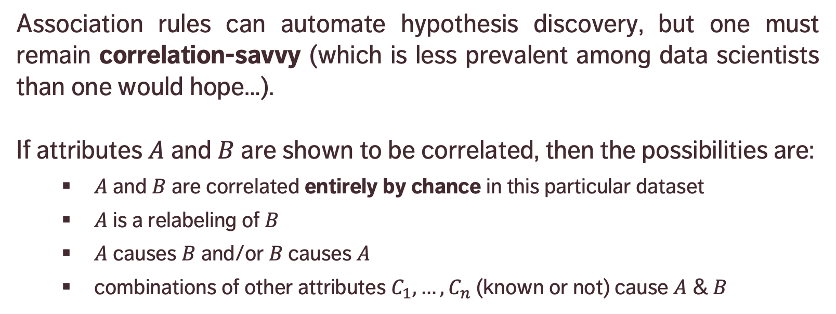
CAUSATION AND CORRELATION
Association rules can automate hypothesis discovery, but one must remain correlation-savvy (which is less prevalent among data scientists than one would hope…).
If attributes $A$ and $B$ are shown to be correlated, then the possibilities are:
$A$ and $B$ are correlated entirely by chance in this particular dataset
$A$ is a relabeling of $B$
$A$ causes $B$ and/or $B$ causes $A$
combinations of other attributes $C_{1},…,C_{n}$ (known or not) cause $A$ & $B$

Slide 22
CAUSATION AND CORRELATION
[E. Siegel, Predictive Analytics: The Power to Predict Who Will Click, Buy, Lie, or Die]
Insight | Organization
Pop-Tarts before a hurricane | Walmart
Higher crime, more Uber rides | Uber
Typing with proper capitalization indicates creditworthiness | A financial services startup company
Users of the Chrome and Firefox browsers make better employees | A human resources professional services firm, over employee data from Xerox and other firms
Men who skip breakfast get more coronary heart disease | Harvard University medical researchers
More engaged employees have fewer accidents | Shell
Smart people like curly fries | Researchers at the University of Cambridge and Microsoft Research
Female-named hurricanes are more deadly | University researchers
Higher status, less polite | Researchers examining Wikipedia behavior

Slide 23
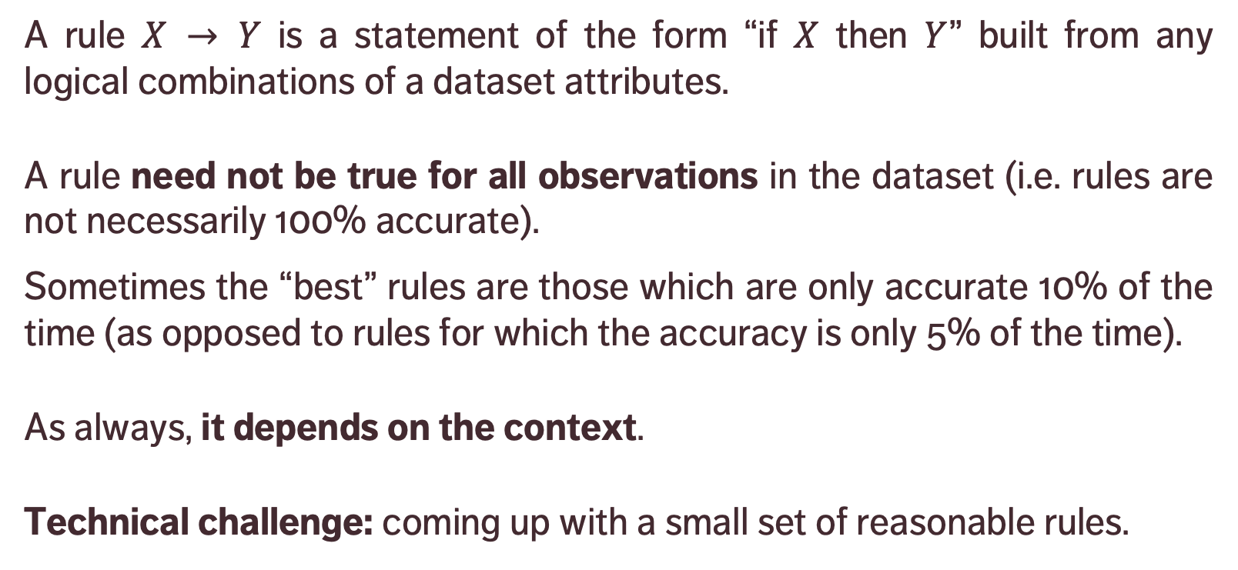
DEFINITIONS
premise
conclusion
A rule $X → Y$ is a statement of the form “if $X$ then $Y$” built from any logical combinations of a dataset attributes.
A rule need not be true for all observations in the dataset (i.e. rules are not necessarily 100% accurate).
Sometimes the “best” rules are those which are only accurate 10% of the time (as opposed to rules for which the accuracy is only 5% of the time).
As always, it depends on the context.
Technical challenge: coming up with a small set of reasonable rules.

Slide 24
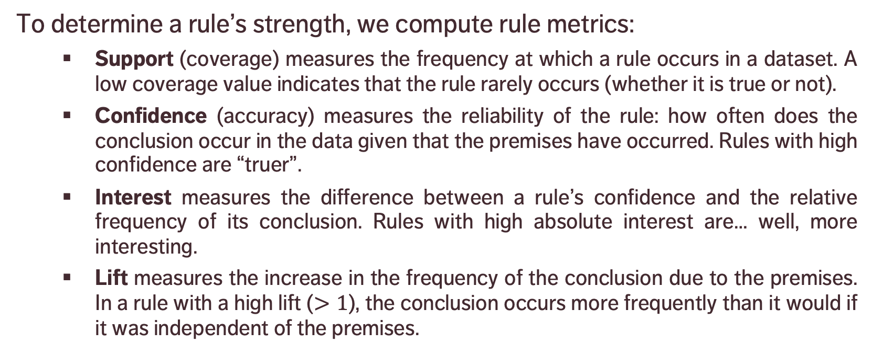
DEFINITIONS
To determine a rule’s strength, we compute rule metrics:
Support (coverage) measures the frequency at which a rule occurs in a dataset. A low coverage value indicates that the rule rarely occurs (whether it is true or not).
Confidence (accuracy) measures the reliability of the rule: how often does the conclusion occur in the data given that the premises have occurred. Rules with high confidence are “truer”.
Interest measures the difference between a rule’s confidence and the relative frequency of its conclusion. Rules with high absolute interest are… well, more interesting.
Lift measures the increase in the frequency of the conclusion due to the premises. In a rule with a high lift ($>1$), the conclusion occurs more frequently than it would if it was independent of the premises.

Slide 25
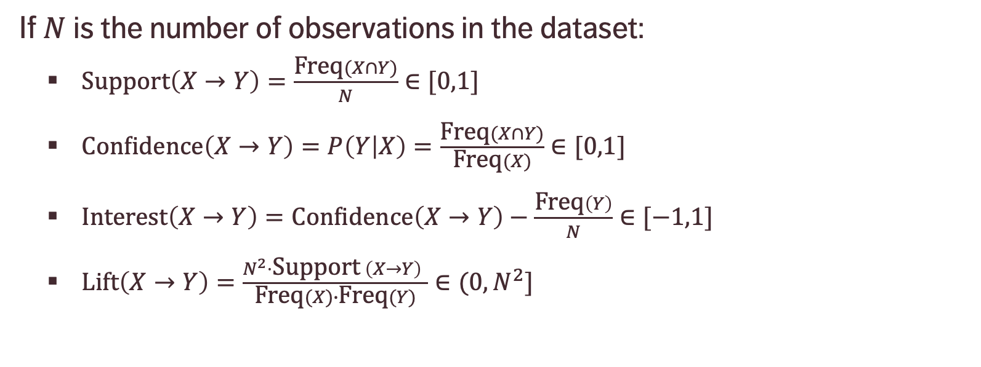
FORMULAS
If $N$ is the number of observations in the dataset:
$\text{Support}\left(X→Y\right)=\frac{\text{Freq}(X∩Y)}{N}∈[0,1]$
$\text{Confidence}\left(X→Y\right)=P\left(Y | X\right)=\frac{\text{Freq}(X∩Y)}{\text{Freq}(X)}∈[0,1]$
$\text{Interest}\left(X→Y\right)=\text{Confidence}\left(X→Y\right)−\frac{\text{Freq}\left(Y\right)}{N}∈[−1,1]$
$\text{Lift}\left(X→Y\right)=\frac{N^{2}⋅\text{Support} \left(X→Y\right) }{\text{Freq}(X)∙\text{Freq}(Y)}∈(0,N^{2}]$
Proportion of instances where the premise and the conclusion occur together
Proportion of instances where the conclusion occurs when the premise occurs
… ?!?

Slide 26
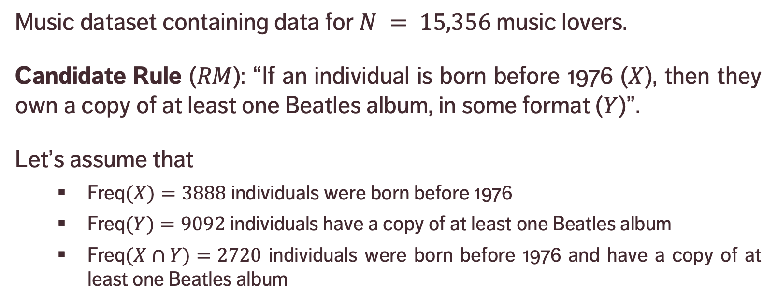
EXAMPLE
Music dataset containing data for $N = 15,356$ music lovers.
Candidate Rule ($RM$): “If an individual is born before 1976 ($X$), then they own a copy of at least one Beatles album, in some format ($Y$)”.
Let’s assume that
$\text{Freq}(X)=3888$individuals were born before 1976
$\text{Freq}(Y)=9092$ individuals have a copy of at least one Beatles album
$\text{Freq}(X∩Y)=2720$ individuals were born before 1976 and have a copy of at least one Beatles album
Notes:
Lift: 70% of those who were born before 1976 own a copy, whereas 56% of those who were born after 1976 own a copy – there is a difference, but it is not large).

Slide 27
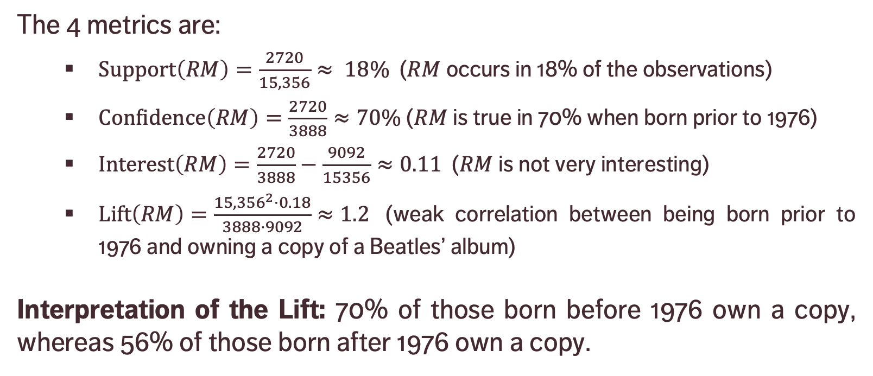
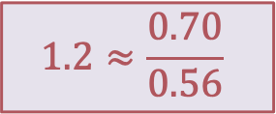
EXAMPLE
$$1.2≈\frac{0.70}{0.56}$$
The 4 metrics are:
$\text{Support}\left(RM\right)=\frac{2720}{15,356}≈ 18\%$ ($RM$ occurs in 18% of the observations)
$\text{Confidence}\left(RM\right)=\frac{2720}{3888}≈70\%$ ($RM$ is true in 70% when born prior to 1976)
$\text{Interest}\left(RM\right)=\frac{2720}{3888}−\frac{9092}{15356}≈0.11$ ($RM$ is not very interesting)
$\text{Lift}\left(RM\right)=\frac{{15,356}^{2}⋅0.18}{3888⋅9092}≈1.2$ (weak correlation between being born prior to 1976 and owning a copy of a Beatles’ album)
Interpretation of the Lift: 70% of those born before 1976 own a copy, whereas 56% of those born after 1976 own a copy.

Slide 28
NOTES
For Big(ger) Data, it can be costly to generate rules in that fashion (especially when the number of attributes increases). How do we generate promising candidate rules, in general?
How reliable are association rules? What is the likelihood that they occur by chance? How relevant are they? Can they be generalized to new data?
Since frequent rules correspond to instances that occur often in the data, algorithms that generate item sets often try to maximize coverage.
When rare events are more meaningful, we need algorithms that can generate rare item sets. This is not a trivial problem.

Slide 29
NOTES
Continuous vs. Categorical: continuous data has to be binned into categorical data in order for association rules to be meaningful. There’s more than one way to do that.
Algorithms:
brute force, AIS, SETM, apriori, aprioriTid, aprioriHybrid, eclat, PCY, multistage, multihash, etc.

Slide 30
EXAMPLE – TITANIC
The Titanic dataset was compiled by Robert Dawson in 1995; it consists of 4 categorical attributes for each of the 2201 people aboard the Titanic when it sank in 1912.
Attributes are:
class (first class, second class, third class, crewmember)
age (adult, child)
sex (male, female)
survival (yes, no)

Slide 31
EXAMPLE – TITANIC
The natural question of interest for this dataset is how survival relates to the other attributes.
We use the arules implementation of apriori in R to generate and prune candidate rules, eventually leading to 8 rules.
Is this a supervised or an unsupervised task?
Would any rule be transferrable to new data?
Notes:
Intro to text analysis
We will be talking about data reduction using NHL game between Ottawa Senators vs. Toronto Maple Leafs on February 18th of 2017

Slide 32
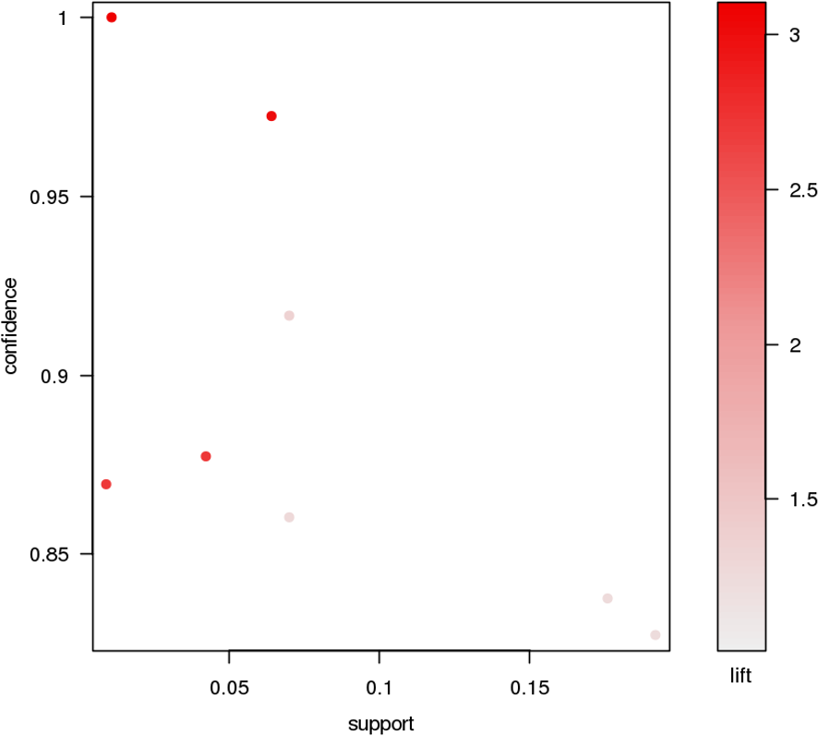
EXAMPLE – TITANIC
Rule | Supp | Conf | Lift
IF class = 2nd AND age = Child THEN survived = Yes | 0.01 | 1 | 3.10
IF class = 1st AND sex = Female THEN survived = Yes | 0.06 | 0.97 | 3.01
IF class = 2nd AND sex = Female THEN survived = Yes | 0.04 | 0.88 | 2.72
IF class = Crew AND sex = Female THEN survived = Yes | 0.00 | 0.87 | 2.70
IF class = 2nd AND sex = Male AND age = Adult THEN survived = No | 0.07 | 0.92 | 1.35
IF class = 2nd AND sex = Male THEN survived = No | 0.07 | 0.86 | 1.27
IF class = 3rd AND sex = Male AND age = Adult THEN survived = No | 0.18 | 0.84 | 1.24
IF class = 3rd AND sex = Male THEN survived = No | 0.19 | 0.83 | 1.22
confidence
lift
support

Slide 33
CLASSIFICATION
STATISTICAL LEARNING
“Data science does not replace statistical modeling and data analysis; it augments them.”
(P. Boily)

Slide 34
CLASSIFICATION OVERVIEW
In classification, a sample set of data (the training set) is used to determine rules and patterns that divide the data into pre-determined groups, or classes (supervised learning; predictive analytics).
The training data usually consists of a randomly selected subset of the labeled (target) data.
Value estimation (regression) is akin to classification when the target variable is numerical.

Slide 35
CLASSIFICATION OVERVIEW
In the testing phase, the model is used to assign a class to observations for which the label is hidden, but ultimately known (the testing set).
The performance of a classification model is evaluated on the testing set, never on the training set.
Technical issues include:
selecting the features to include in the model
selecting the algorithm
etc.

Slide 36
APPLICATIONS
Medicine and Health Science
predicting which patient is at risk of suffering a second, fatal heart attack within 30 days based on health factors (blood pressure, age, sinus problems, etc.)
Social Policies
predicting the likelihood of requiring assisting housing in old age based on demographic information/survey answers
Marketing and Business
predicting which customers are likely to switch to another cell phone company based on demographics and usage

Slide 37
EXAMPLE
Scenario: a motor insurance company has a fraud investigation dept. that studies up to 30% of all claims made, yet money is still getting lost on fraudulent claims.
Questions: can we predict
whether a claim is likely to be fraudulent?
whether a customer is likely to commit fraud in the near future?
whether an application for a policy is likely to result in a fraudulent claim?
the amount by which a claim will be reduced if it is fraudulent?

Slide 38
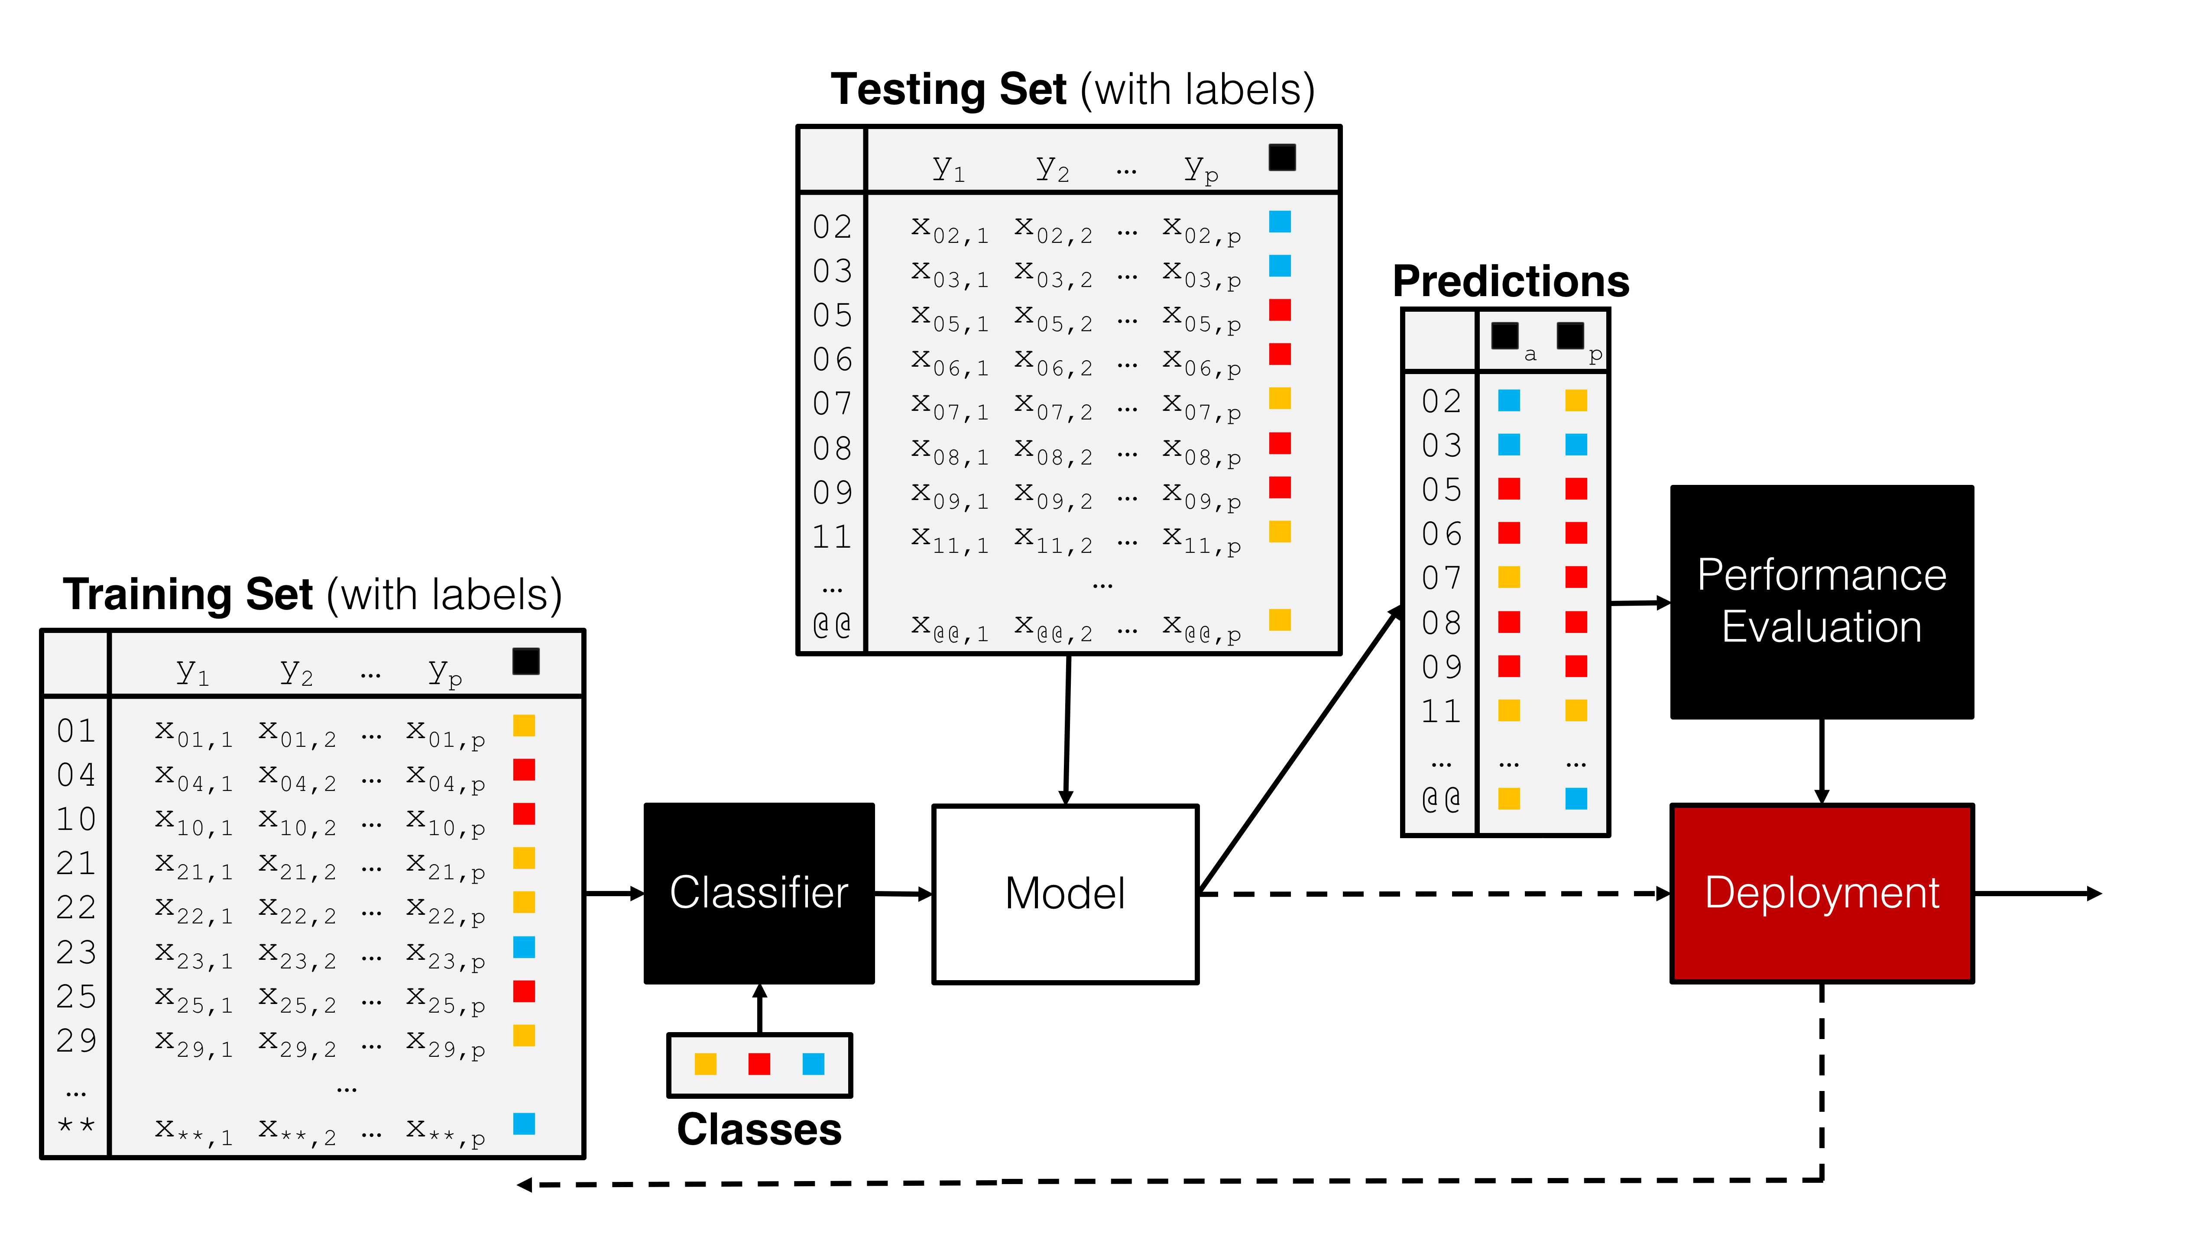
Testing Set (with labels)
Predictions
Training Set (with labels)
Performance Evaluation
Classifier
Model
Deployment
Classes

Slide 39
CLASSIFICATION METHODS
Logistic Regression
Neural Networks
Decision Trees
Naïve Bayes Classifiers
Support Vector Machines
Nearest Neighbours Classifiers
etc.

Slide 40
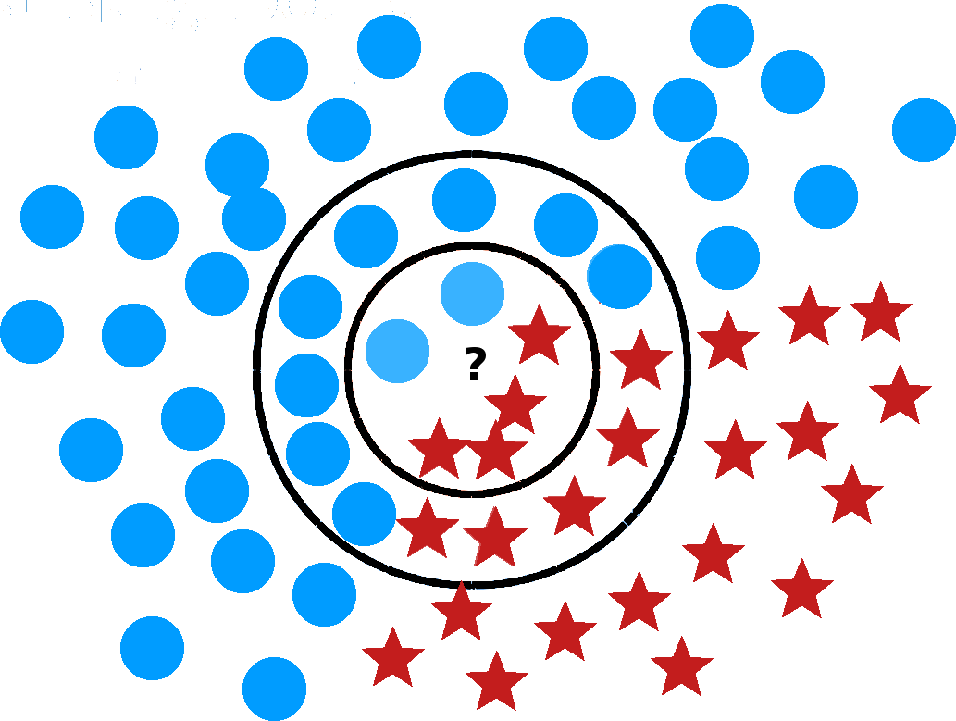
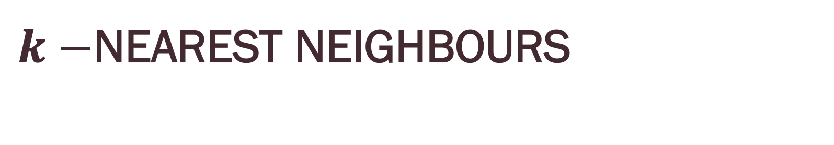
$k−$NEAREST NEIGHBOURS

Slide 41
SUPPORT VECTOR MACHINES
[Adapted from Foster & Provost’s Data Science for Business]
Age
Margin
Balance

Slide 42
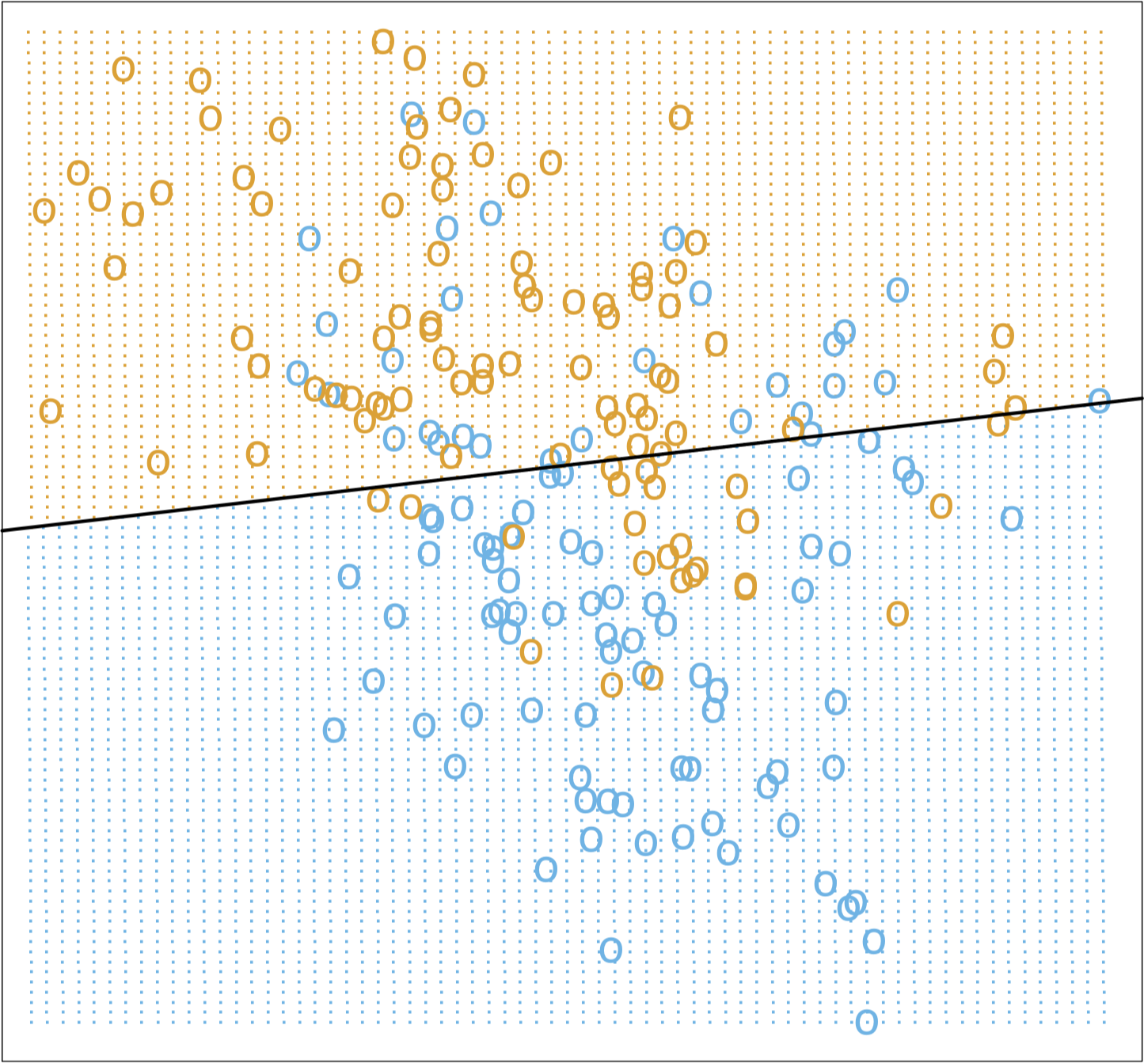
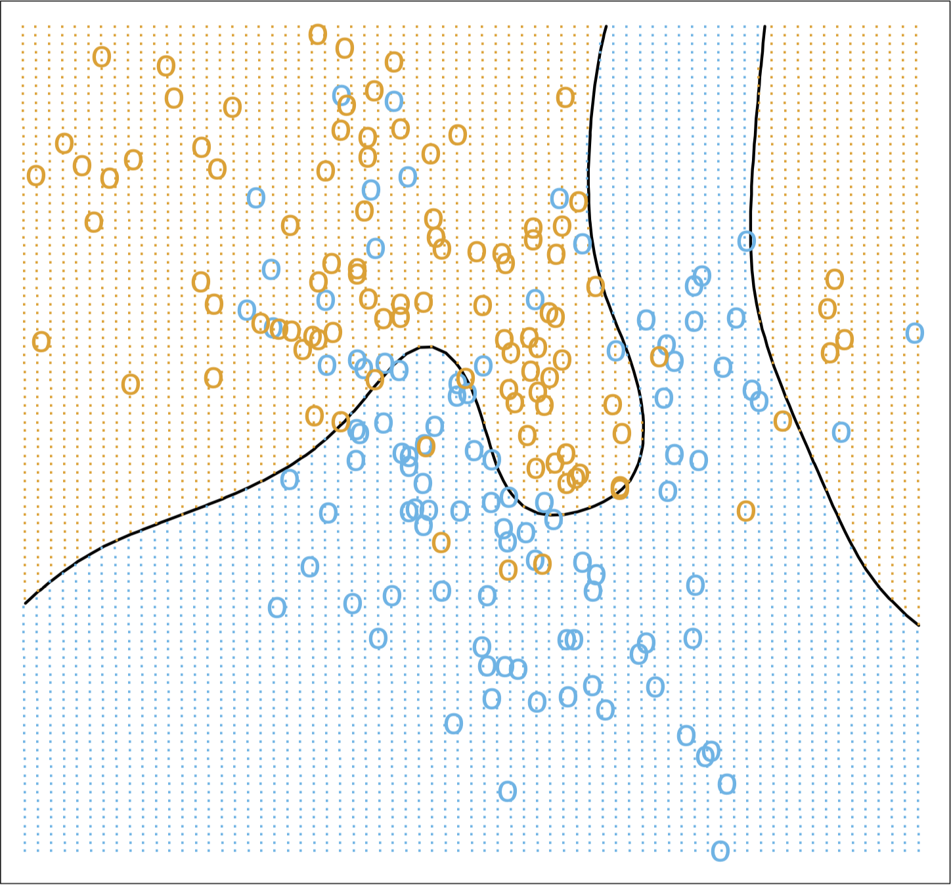
BOUNDARY CLASSIFIERS
[Images taken from The Elements of Statistical Learning]
Linear Regression Classifier
Optimal Bayes Classifier

Slide 43
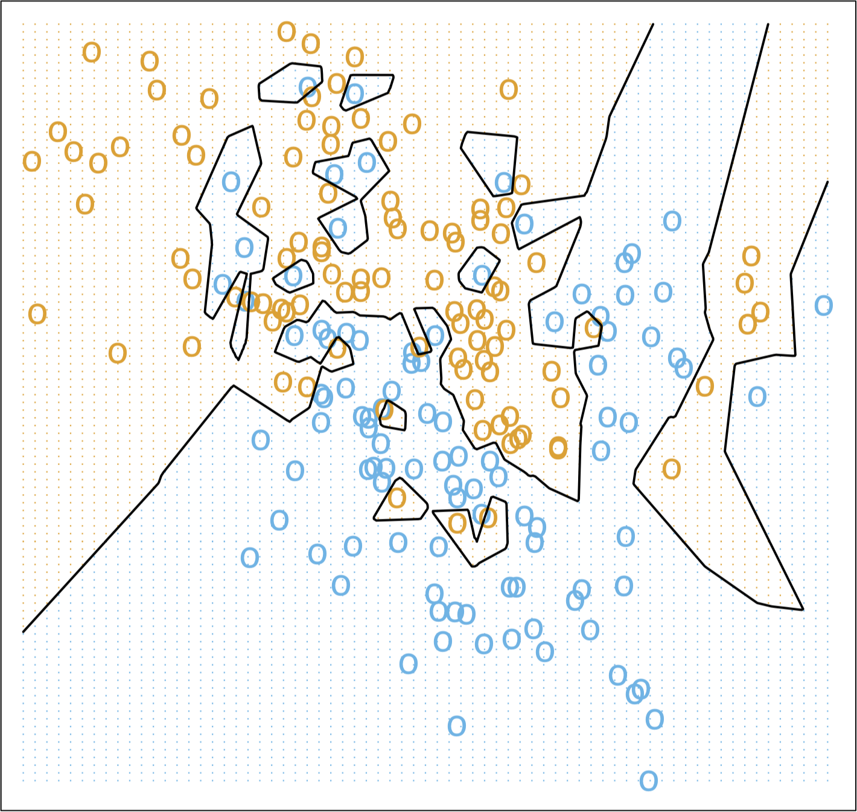
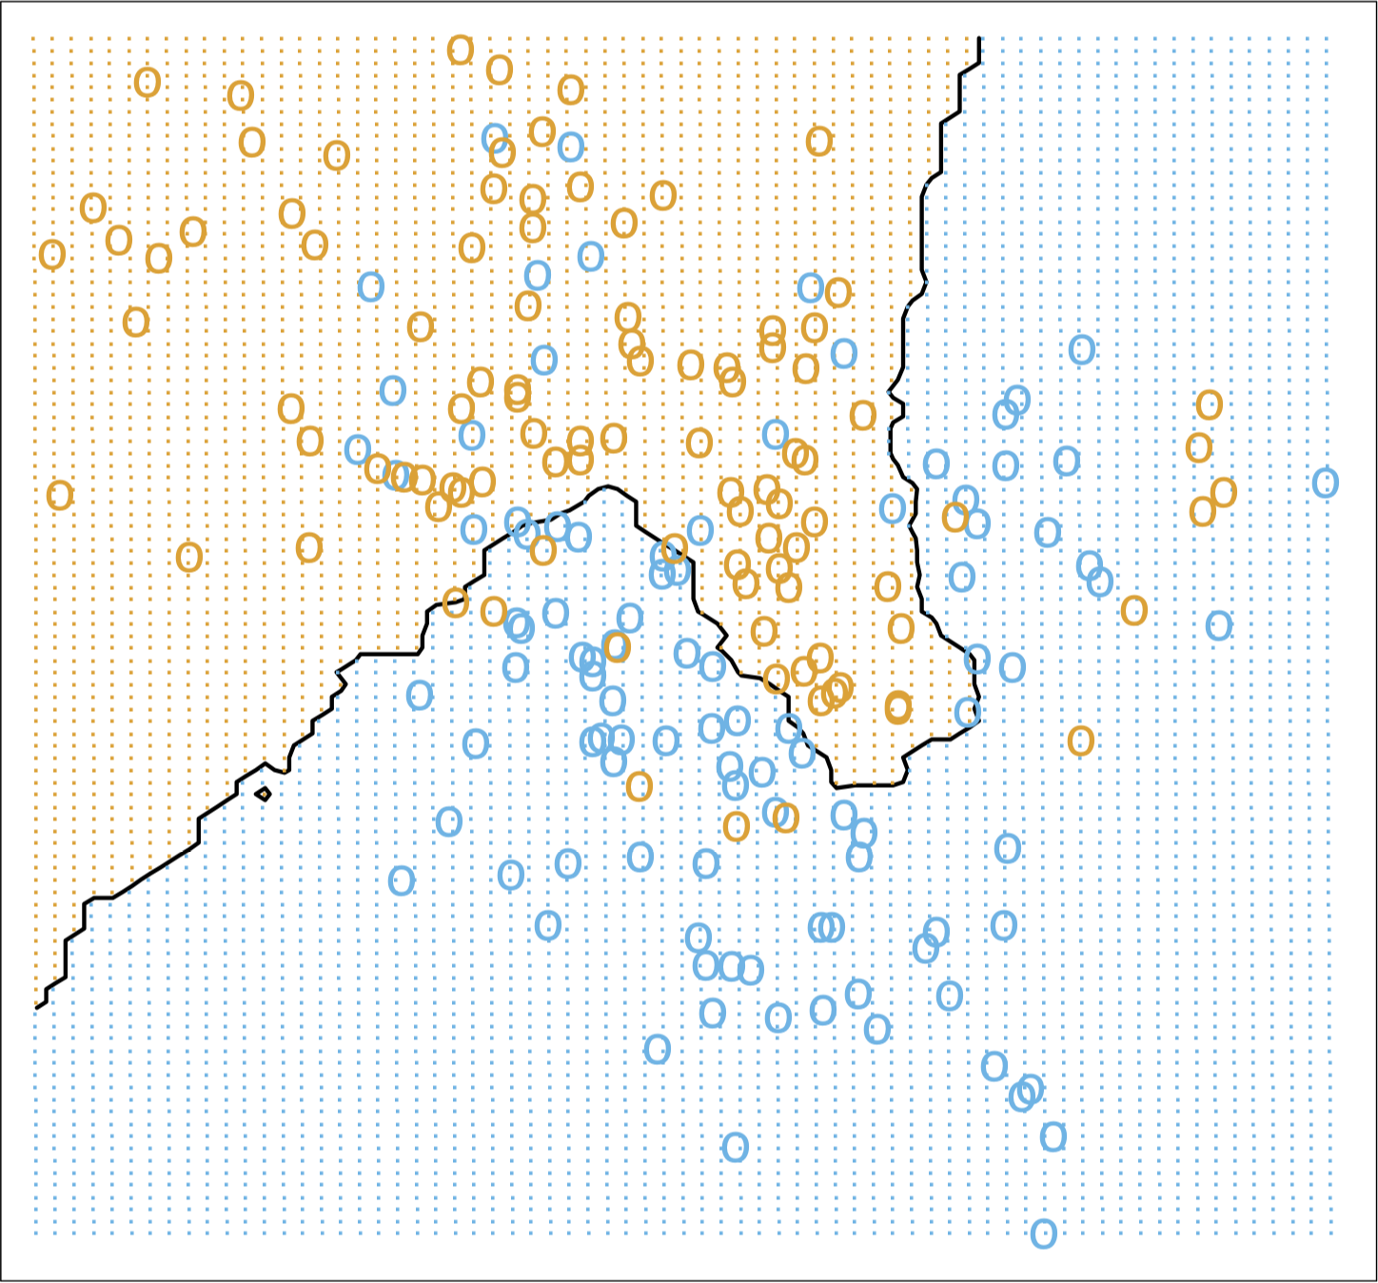
NEAREST NEIGHBOURS CLASSIFIERS
[Images taken from The Elements of Statistical Learning]
1NN Classifier
15NN Classifier

Slide 44
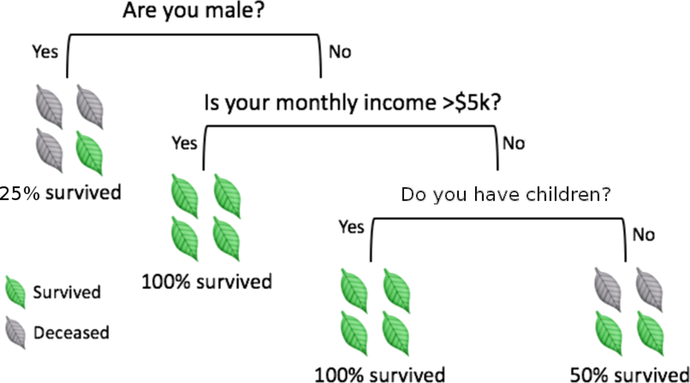
DECISION TREES
[adapted from A. Ng, K. Soo, Numsense!, Surviving a Disaster]
Decision trees are perhaps the most intuitive of these methods.
Classification is achieved by following a path up the tree, from its root, through its branches, and ending at its leaves.

Slide 45
DECISION TREES
To make a prediction for a new instance, follow the path down the tree, reading the prediction directly once a leaf is reached.
Creating the tree and traversing it might be time-consuming if there are too many variables.
Prediction accuracy can be a concern in trees whose growth is unchecked. In practice, the criterion of purity at the leaf-level is linked to bad prediction rates for new instances.
other criteria are often used to prune trees, which may lead to impure leaves (i.e. with non-trivial entropy).

Slide 46
DECISION TREES STRENGTHS AND LIMITATIONS
Limitations:
not as accurate as other algorithms (usually)
not robust
particularly vulnerable to overfitting
optimal decision tree learning is NP-complete
biased towards categorical features with high number of levels
Strengths:
white box model
can be used with incomplete datasets
built-in feature selection
makes no assumption about data

Slide 47
DECISION TREE NOTES
Splitting Metrics
information gain, Gini impurity, variance reduction, etc.
Common Algorithms
iterative Dichotomiser 3, C4.0, C4.5, CHAID, MARS, CI trees, CART
decision trees can also be combined together using boosting algorithms (AdaBoost) or Random Forests, providing a type of voting procedure (Ensemble Learning)

Slide 48
OTHER POINTS TO PONDER
Classification is linked to probability estimation
approaches based on regression models could prove fruitful
Rare occurrences (often more interesting/important) continue to plague classification attempts
historical data at Fukushima's nuclear reactor prior to the meltdown could not have been used to learn about meltdowns
No Free-Lunch Theorem: no classifier works best for all data.
With big datasets, algorithms must also consider efficiency.

Slide 49
PERFORMANCE EVALUATION
Classifiers are evaluated on the testing set.
Ideally, a good classifier would have
high rates of both True Positives (TP) and True Negatives (TN), and
low rates of both False Positives (FP) and False Negatives (FN).
Evaluation metrics mean very little on their own: context requires comparison with other classifiers, and other evaluation metrics.

Slide 50
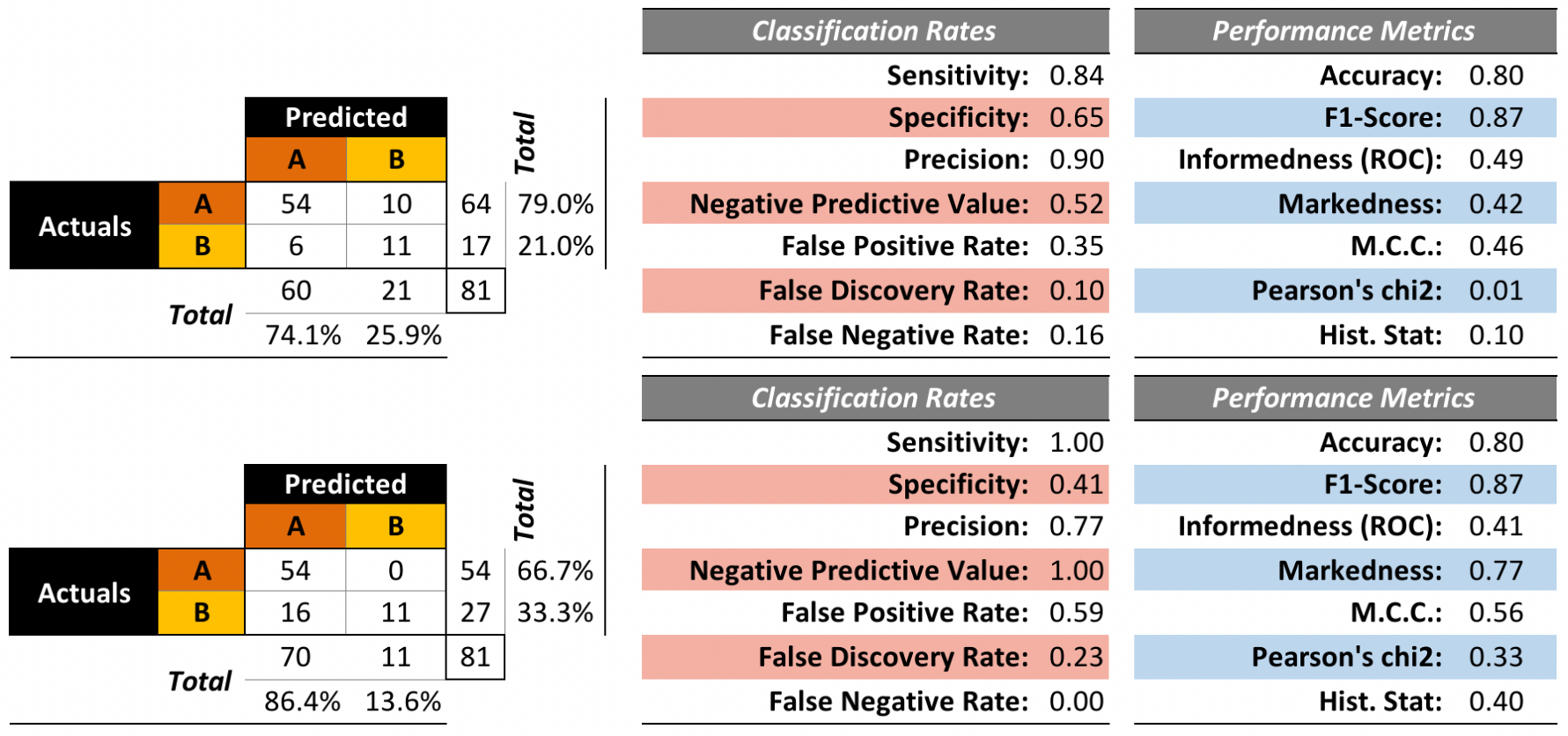
PERFORMANCE EVALUATION

Slide 51
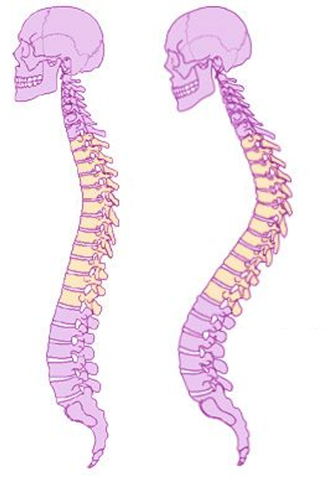
EXAMPLE – KYPHOSIS
Kyphosis is a medical condition related to the excessive convex curvature of the spine. Corrective spinal surgery is at times performed on children.
The dataset has 81 observations and 4 attributes:
kyphosis (absent or present after operation)
age (at time of operation, in months)
number (of vertebrae involved)
start (topmost vertebra operated on)

Slide 52
EXAMPLE – KYPHOSIS
The question of interest for this natural dataset is how the three explanatory attributes might impact the operation’s success.
We use the rpart implementation of CART to generate candidate decision trees.
Strictly speaking, this is not a predictive supervised task as we treat the entire dataset as a training set (no hold-out testing observations).
Notes:
Intro to text analysis
We will be talking about data reduction using NHL game between Ottawa Senators vs. Toronto Maple Leafs on February 18th of 2017

Slide 53
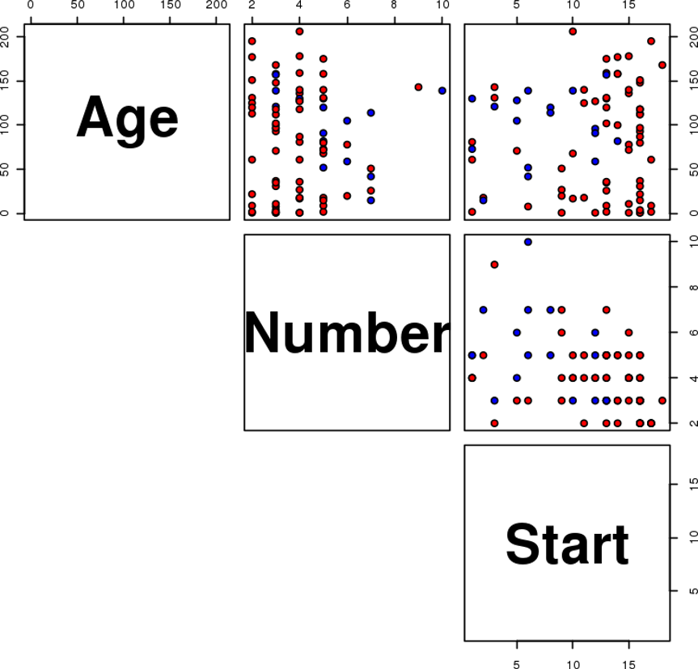
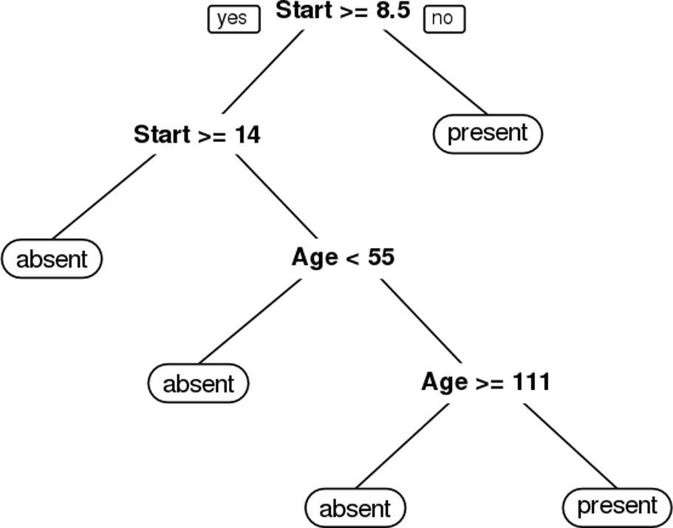
EXAMPLE – KYPHOSIS
present
absent

Slide 54
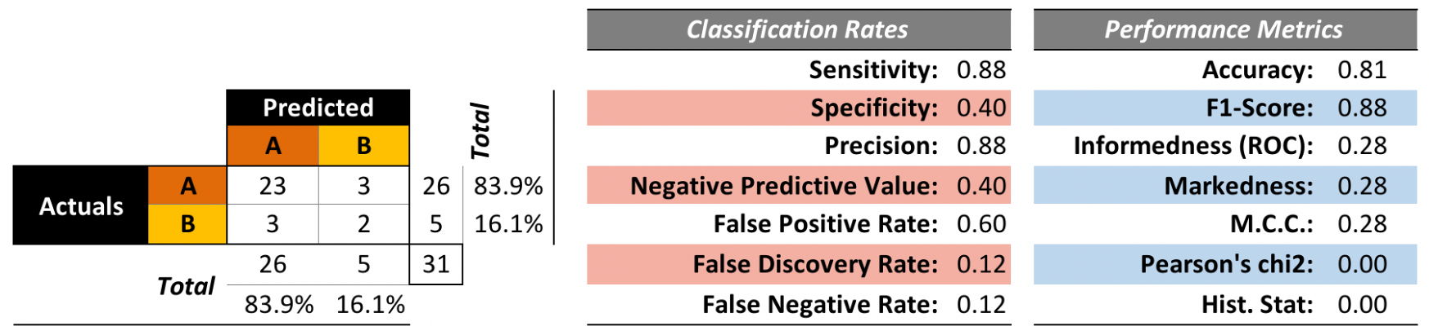
EXAMPLE – KYPHOSIS
We train a model on 50 randomly selected observations and evaluate the performance on the remaining 31 observations.
Is this a good model?

Slide 55
CLUSTERING
STATISTICAL LEARNING
“Data is not information, information is not knowledge, knowledge is not understanding, understanding is not wisdom.”
(C. Stoll)

Slide 56
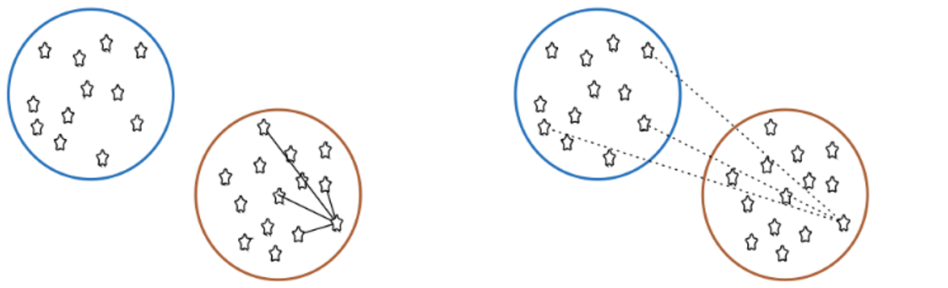
CLUSTERING OVERVIEW
In clustering, the data is divided into naturally occurring groups. Within each group, the data points are similar; from group to group, they are dissimilar.
average distance to points in own cluster (low is good)
average distance to points in neighbouring cluster (high is good)
The grouping labels are not determined ahead of time, so clustering is an example of unsupervised learning.

Slide 57
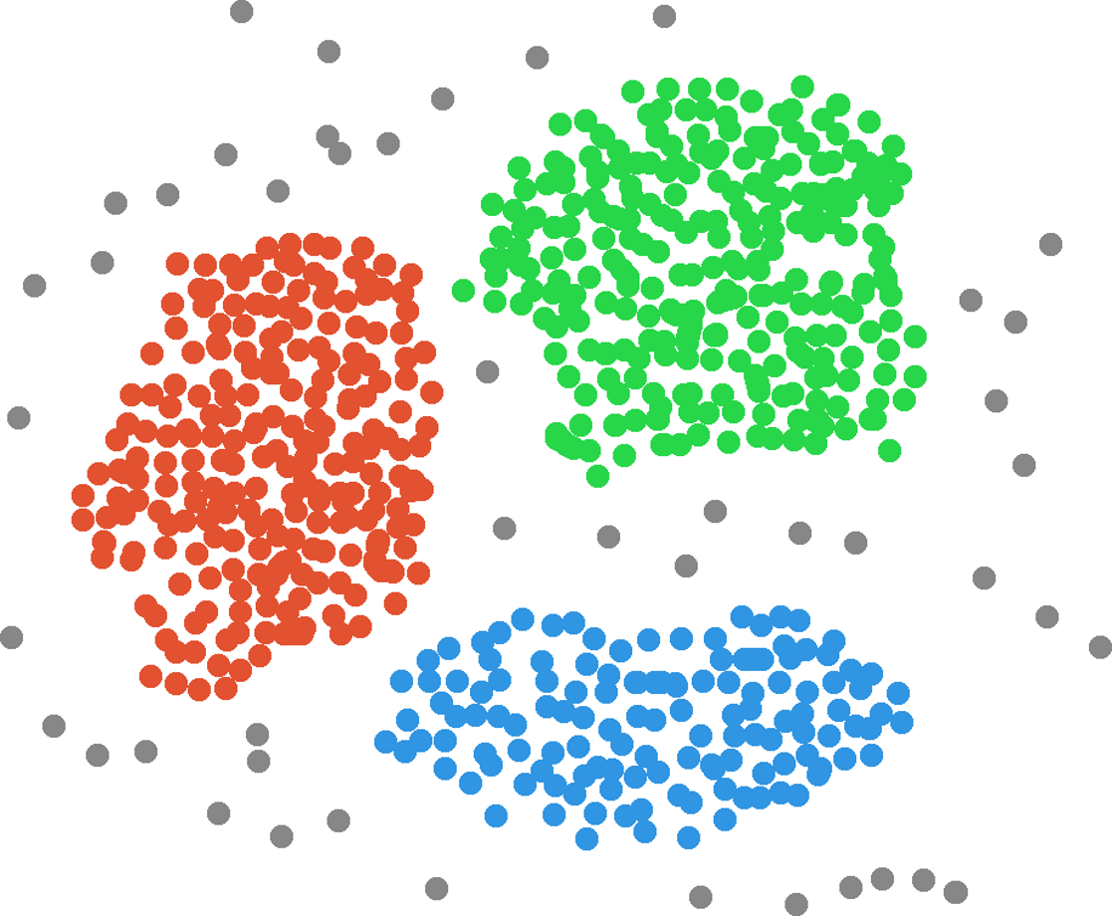
Income
Customers
Clusters
Age

Slide 58
CLUSTERING OVERVIEW
Clustering is a relatively intuitive concept for human beings as our brains do it unconsciously
facial recognition
searching for patterns, etc.
In general, people are very good at messy data, but computers and algorithms have a harder time.
Part of the difficulty is that there is no agreed-upon definition of what constitutes a cluster:
“I may not be able to define what it is, but I know one when I see one”

Slide 59
CLUSTERING OVERVIEW
Clustering algorithms can be complex and non-intuitive, based on varying notions of similarities between observations.
in spite of that, the temptation to explain clusters a posteriori is strong
They are also (typically) non-deterministic:
the same algorithm, applied twice (or more) to the same dataset, can discover completely different clusters
the order in which the data is presented can play a role
so can starting configurations

Slide 60
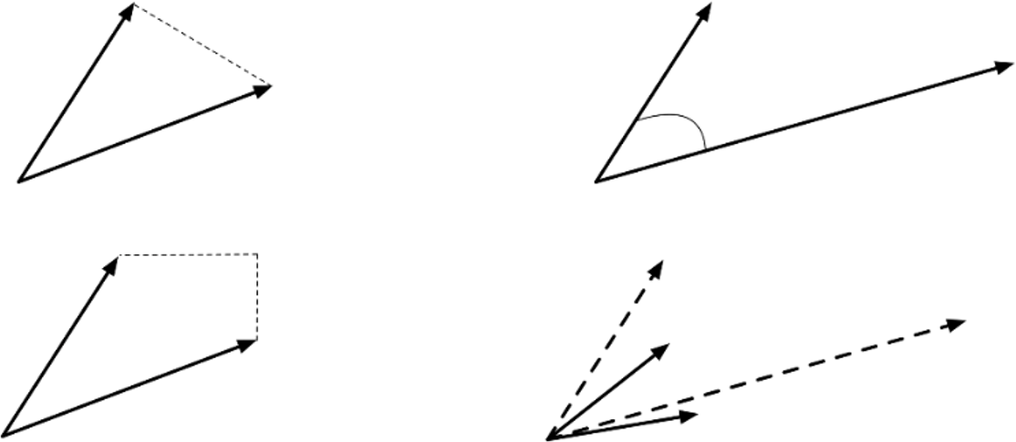
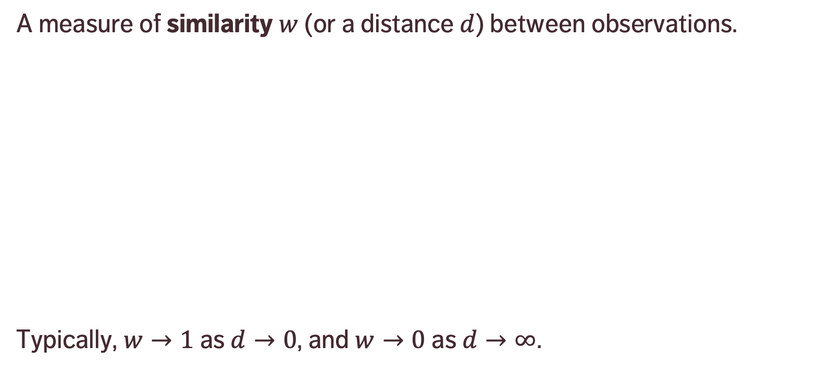
CLUSTERING REQUIREMENT
IMPORTANT: data must be scaled before it is fed into clustering algorithms.
A measure of similarity $w$ (or a distance $d$) between observations.
Typically, $w→1$ as $d→0$, and $w→0$ as $d→∞$.
Euclidean distance (as the crow flies)
Cosine distance (angle between vectors)
Manhattan distance (you might have to drive)
Transform (normalize, center) before calculating distance

Slide 61
APPLICATIONS
Text Documents
grouping similar documents according to their topics, based on the patterns of common and unusual words
Product Recommendations
grouping online purchasers based on the products they have viewed, purchased, liked, or disliked
grouping products based on customer reviews
Marketing and Business
grouping client profiles based on their demographics and preferences

Slide 62
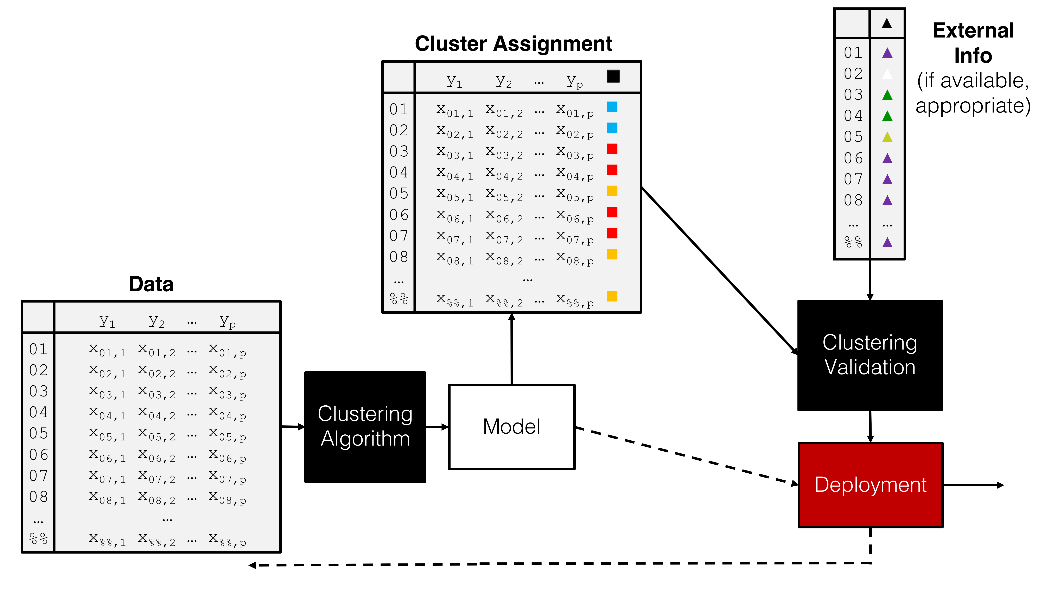
Cluster Assignment
Eternal Info (if available & appropriate)
Data
Clustering Validation
Clustering Algorithm
Model
Deployment

Slide 63
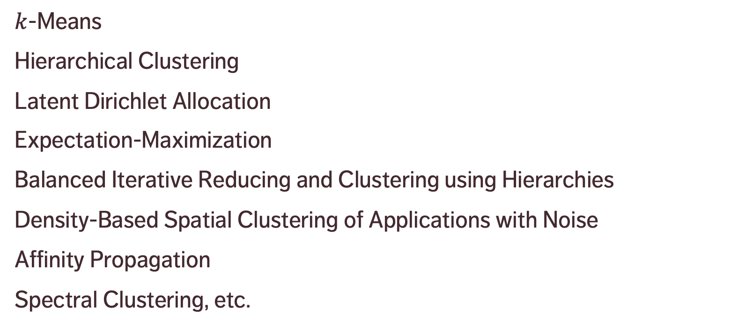
CLUSTERING METHODS
$k$-Means
Hierarchical Clustering
Latent Dirichlet Allocation
Expectation-Maximization
Balanced Iterative Reducing and Clustering using Hierarchies
Density-Based Spatial Clustering of Applications with Noise
Affinity Propagation
Spectral Clustering, etc.

Slide 64
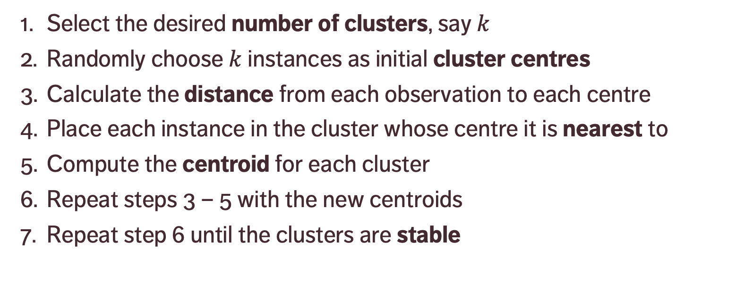
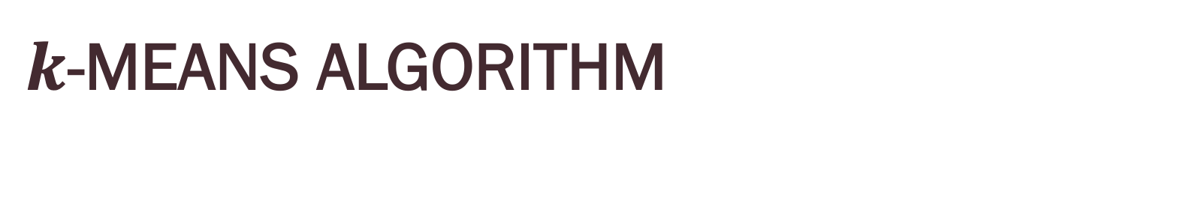
$k$-MEANS ALGORITHM
Select the desired number of clusters, say $k$
Randomly choose $k$ instances as initial cluster centres
Calculate the distance from each observation to each centre
Place each instance in the cluster whose centre it is nearest to
Compute the centroid for each cluster
Repeat steps 3 – 5 with the new centroids
Repeat step 6 until the clusters are stable

Slide 65
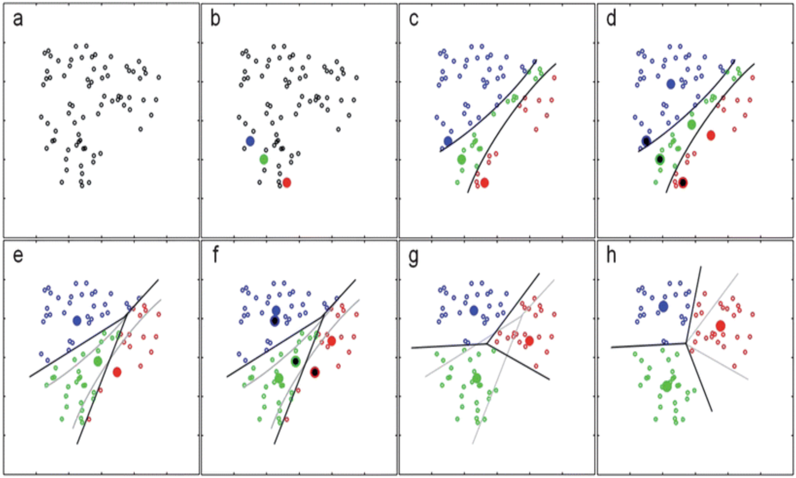
[https://notebook.community/alanhdu/AccessibleML/4. K-means clustering and unsupervised learning]

Slide 66
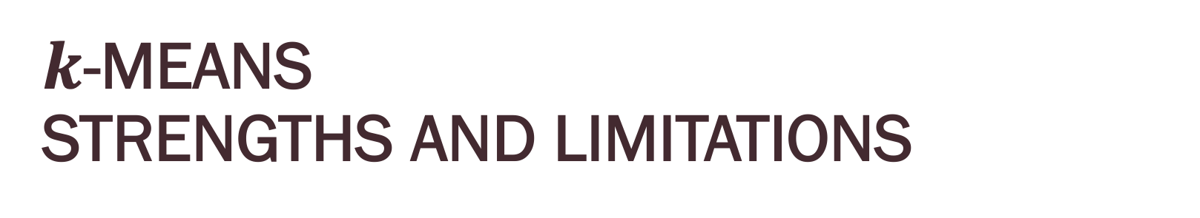
$k$-MEANS STRENGTHS AND LIMITATIONS
Limitations:
points can only be assigned to one cluster
underlying clusters are assumed to be blob-shaped
clusters are assumed to be discrete (separate entities)
Strengths:
easy to implement
often a natural way to group observations
helps provide a basic understanding of the data structure in a first pass

Slide 67
CLUSTERING VALIDATION
What does it mean for a clustering scheme to be better than another?
What does it mean for a clustering scheme to be valid?
What does it mean for a single cluster to be good?
How many clusters are there in the data, really?
Right vs. wrong is meaningless: seek optimal vs. sub-optimal.

Slide 68
CLUSTERING VALIDATION
Optimal clustering scheme
maximal separation between clusters
maximal similarity within groups
agrees with human eye test
useful at achieving its goals
Validation types
external (uses additional information)
internal (uses only the clustering results)
relative (compares across clustering attempts)

Slide 69
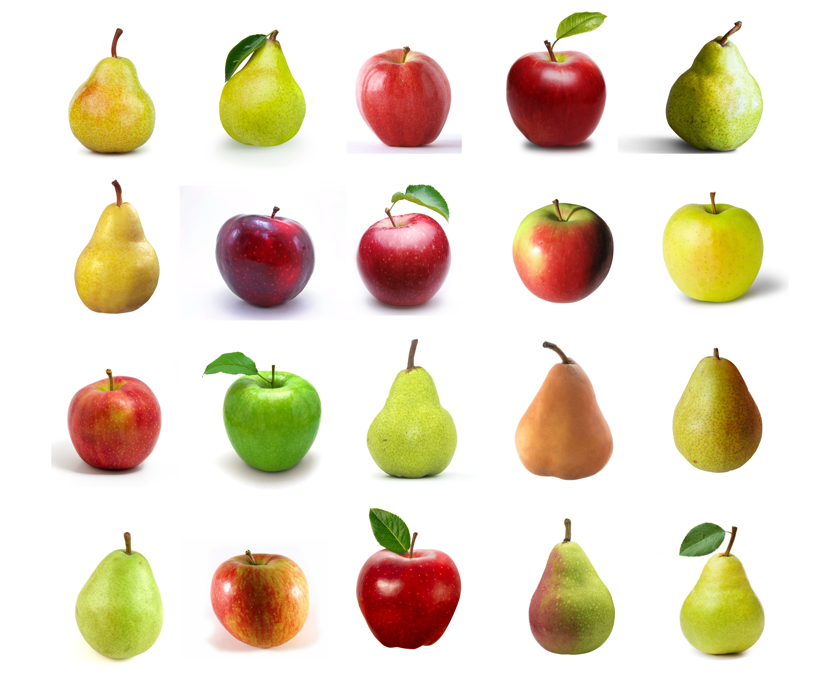
EXAMPLE – FRUIT IMAGES
20 images of fruit.
Are there right or wrong groupings of this dataset?
Are there multiple possible ‘natural’ clusterings?
Could different clusterings be used differently?
Will some clusterings be of (objectively) higher quality than others?

Slide 70
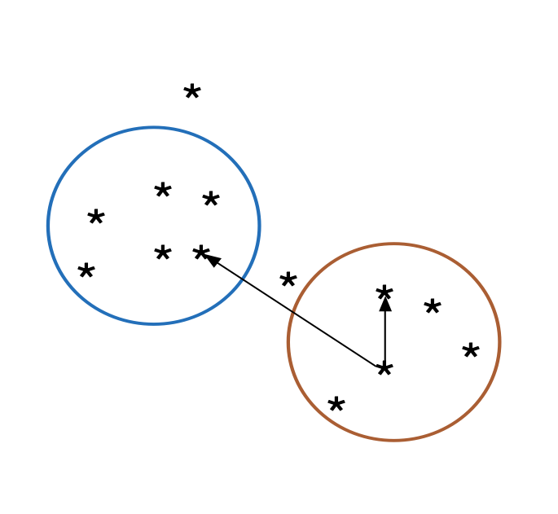
VALIDITY VS. QUALITY
Context is very relevant to the quality of a given clustering, but what if we have no context?
Is there a way to objectively measure cluster quality without any specific context?
The term ‘validity’ suggests there is a correct clustering, against which we compare performance.
Lewis, Ackerman, de Sa (2012) speak of Clustering Quality Measures (CQM) instead.

Slide 71
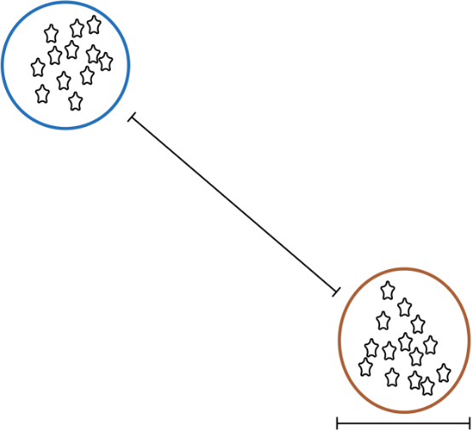
BROAD GOALS OF CQMs
Within clusters, everything is very similar. Between clusters, there is a lot of difference.
The problem: there are many ways for clusters to deviate from this ideal.
How do we weigh the good aspects (e.g. high within-cluster similarity) relative to the bad (e.g. low between cluster separation).
Result: a huge number of CQMs (30+).
Large between-cluster difference
Small within- cluster difference

Slide 72
CLUSTERING CHALLENGES
Automation
Lack of a clear-cut definition
Lack of repeatability
Number of clusters
Cluster description
Model validation
Ghost clustering
A posteriori rationalization

Slide 73
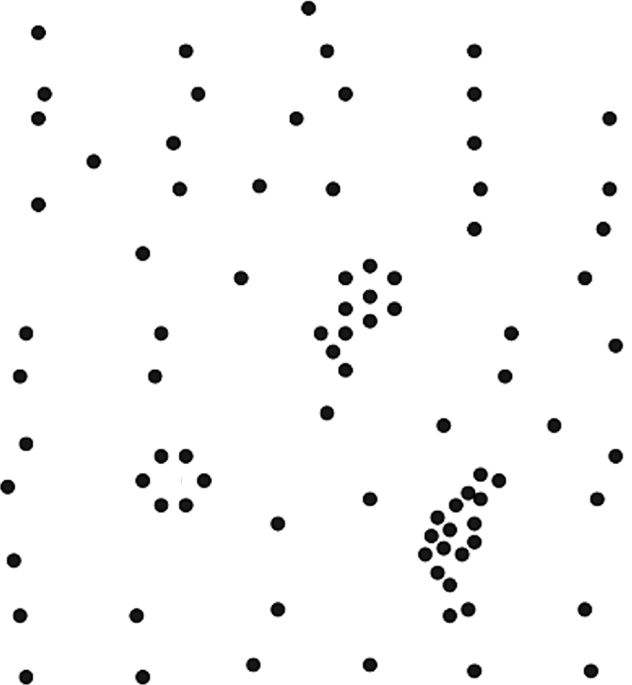

Slide 76
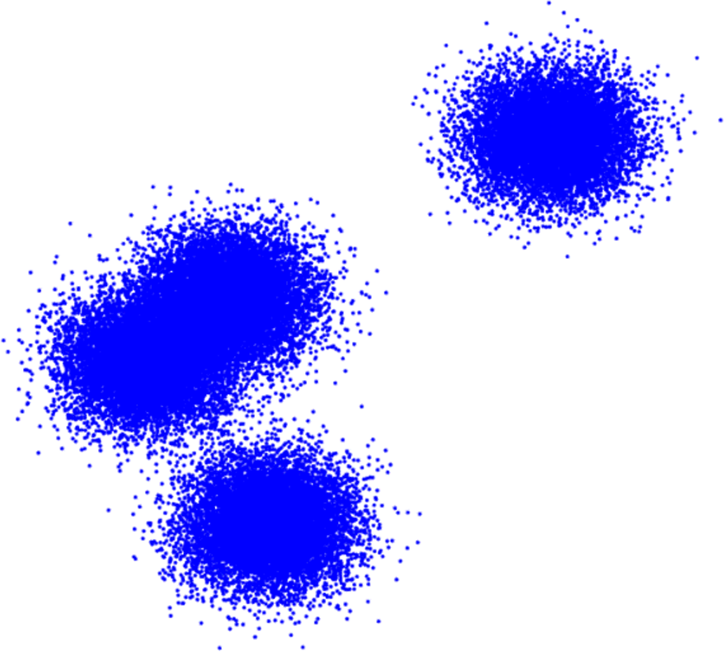

Slide 77
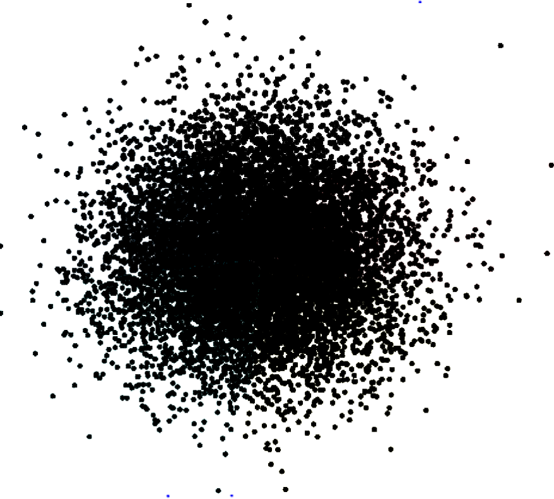

Slide 78
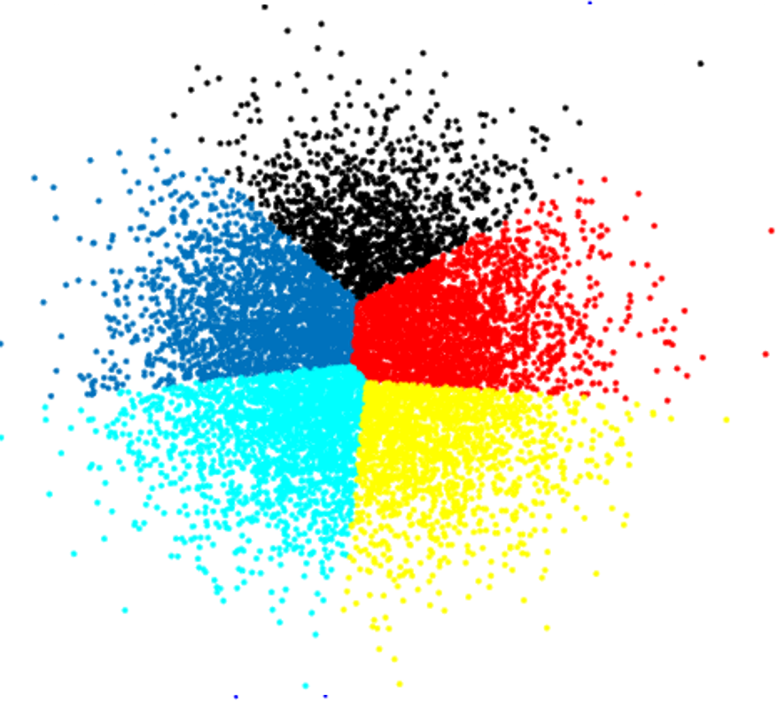

Slide 79
ISSUES & CHALLENGES
STATISTICAL LEARNING
“We all say we like data, but we don’t. We like getting insight out of data. That’s not quite the same as liking data itself. In fact, I dare say that I don’t quite care for data, and it sounds like I’m not alone.”
(Q.E. McCallum, Bad Data Handbook)

Slide 80
BAD DATA
Does the dataset pass the smell test? (invalid entries, etc.)
Difficulties with text processing (encoding, application-specific characters)
Collecting data online (legality of obtaining data, storing offline versions)
Detecting lies and mistakes (reporting errors, use of polarizing language)
Data and reality: bad data vs. bad reality?
Is close enough, good enough? (completeness, coherence, correctness, accountability)

Slide 81
BAD DATA
Sources of bias and errors: imputation bias, replacing extreme values with average values, head of household reports for household, etc.
Seeking perfection (academic, professional, government, service data)
Data science pitfalls: analysis without understanding, using only one tool (by choice/fiat), analysis for the sake of analysis, unrealistic expectations of data science, it’s on a need-to-know basis and you don’t need to know.
Databases vs. files vs. cloud computing (the cloud will solve our problems!)

Slide 82
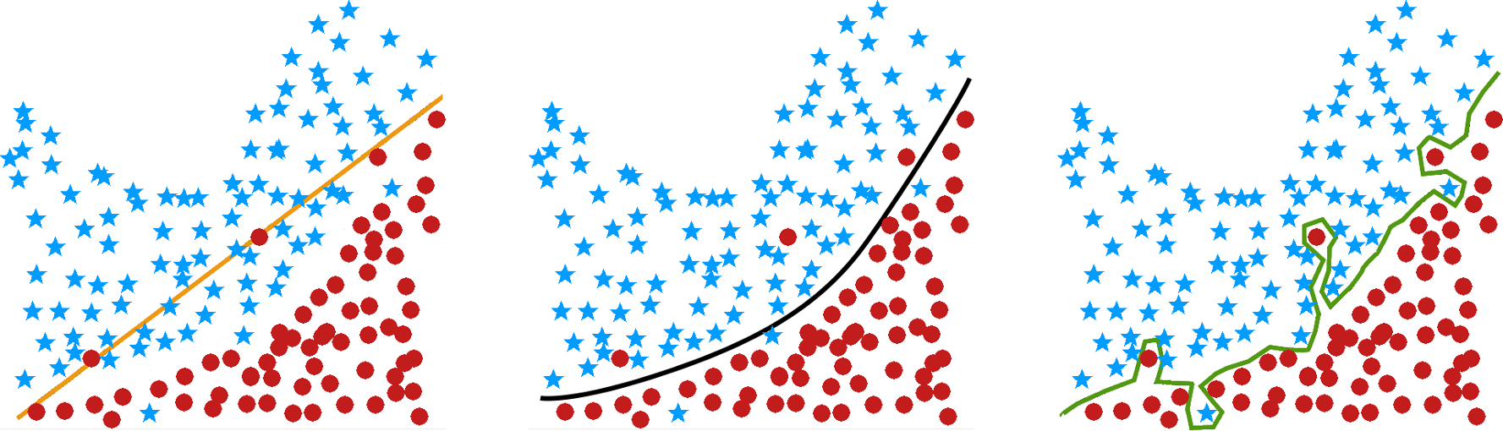
OVERFITTING
underfit
just right
overfit

Slide 83
OVERFITTING
The hope is for rules or models generated by any technique on a training set to be generalizable to new data (or validation/ testing sets).
Problems arise when knowledge that is gained from supervised learning does not generalize properly to the data (unsupervised learning can also be affected).
Ironically, this may occur if the rules or models fit the training set too well – the results are too specific to the training set.
Evaluate on unseen data and be wary of models built on all available data.

Slide 84
OVERFITTING EXAMPLE
Rule I: based on a survey of 400 Germans, we infer that 43.75% of the world’s population has black hair, 37.5% have brown hair, 9% have blond hair, 0.25% have red hair, and 9.5% grey hair.
Rule II: humans’ hair colour is either black, brown, blond, red, or grey.
Rule III: approx. 40% of humans have black hair, 40% have brown hair, 5% blond, 2% red and 13% grey.

Slide 85
BIG DATA VS. SMALL DATA
What is the main difference?
datasets are LARGE
issues: collection, capture, access, storage, analysis, visualization
Where does the data come from?
technology advances are lifting the limits on data processing speeds
information-sensing, mobile devices, cameras and wireless networks
What are the challenges?
most techniques were built for very small dataset
direct approach will leave the best analyst waiting years for results

Slide 86
THE 5-V PARADIGM
Volume: large amounts of data
Velocity: speed at which data is created, accessed, processed
Variety: different types of available data, can’t all be saved in relational databases (tables, pictures,…)
Veracity: quality and accuracy of big data is harder to control
Value: turn the data into something useful
Variability
Visualization

Slide 87
THE BIG DATA PROBLEM
Many computations happen instantly, others take a significant amount of time.
Crunching very large datasets is a perfect example. Analysis in R or Python with steadily larger datasets leads to computer lags. Eventually, the time required becomes impractically long.
Optimizing code and using a faster CPU can only provide so much relief.
That is the Big Data problem.

Slide 88
DISTRIBUTED COMPUTING
Splitting the computations among multiple CPU cores/CPUs can divide the computation time by a factor of 4, or 32, or 1000.
This allows algorithms to run on big data to keep analytics, smart services, and recommendations updated daily, hourly, in real time.
Election analogy to parallelization:
counting votes at different polling stations in a riding
each station simultaneously counts its own votes and reports their total
the totals of all polling stations are aggregated at Elections HQ
one person counting all the ballots would eventually get the same result, but it would take too long to get the result.

Slide 89
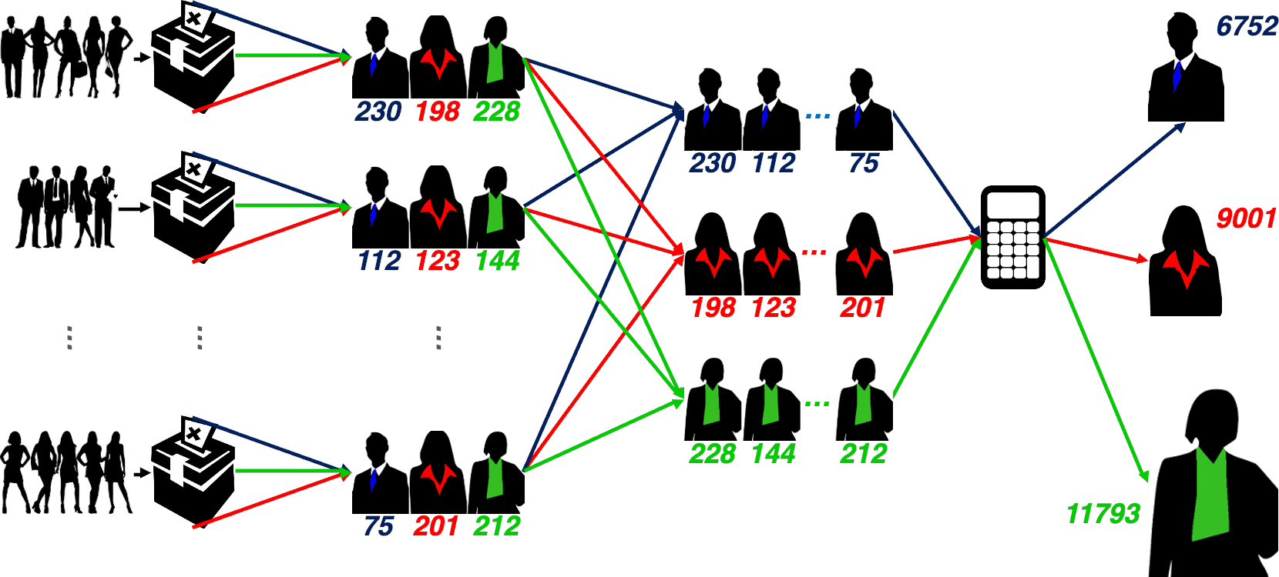

Slide 90
SERIAL PROCESSING
The gains from parallelism depend on whether serial algorithms can be adapted to make use of parallel hardware.
Pizzeria analogy for limitations of parallelization/bottleneck:
multiple cooks can prepare toppings in parallel
but baking the crust can't be parallelized
doubling oven space will increase the number of pizzas that can be made simultaneously but won't substantially speed up any one pizza
sometimes bottlenecks prevent any gains from parallelism: people line up on both sides of a table to get some soup but there's only one ladle
Most practical computational tasks can be and are parallelized.

Slide 91
[https://hbr.org/2013/07/how-google-flu-trends-is-getting-to-the-bottom]
“It can be tempting to use data as a crutch in decision-making: “The data says so!” But sometimes the data lets us down and that exciting correlation you found is just a by-product of a messy, biased sample. [...] Smart skeptics can help step back, reflect, and ask if what the data is saying actually fits with what you know and expect about the world.”
(N. Diakopoulos, Harvard Business Review)

Slide 92
APPROPRIATENESS AND TRANSFERABILITY
Data science models are used heavily.
We have discussed pros and cons of some of the applications on ethical and other non-technical grounds, but there are also technical challenges.
Data Science methods are not appropriate if:
if one absolutely must use an existing (legacy) datasets instead of an ideal dataset (“it’s the best data we have!”)

Slide 93
APPROPRIATENESS AND TRANSFERABILITY
Data Science methods are not appropriate if (continued):
the dataset has attributes that usefully predict a value of interest, but which are not available when a prediction is required
Example: the total time spent on a website may be predictive of a visitor’s future purchases, but the prediction must be made before the total time spent on the website is known…
if one will attempt to predict class membership using an unsupervised learning algorithm
Example: clustering loan default data might lead to a cluster contains many defaulters. If new instances get added to this cluster, should they be viewed as loan defaulters?

Slide 94
NON-TRANSFERABLE ASSUMPTIONS
Every model makes certain assumptions about what is and is not relevant to its workings, but there is a tendency to only gather data which is assumed to be relevant to a particular situation.
If data is used in other contexts, or to make predictions depending on attributes without data, validating the results is impossible.
Example: can we use a model that predicts mortgage defaulters to also predict car loan defaulters?

Slide 95
BIASES, FALLACIES & INTERPRETATION
Correlation is not causation (but it is a hint!)
Extreme patterns can mislead.
Stay within a study's range.
Keep the base rate in mind.
Odd results sometimes happen (Simpson's Paradox).

Slide 96
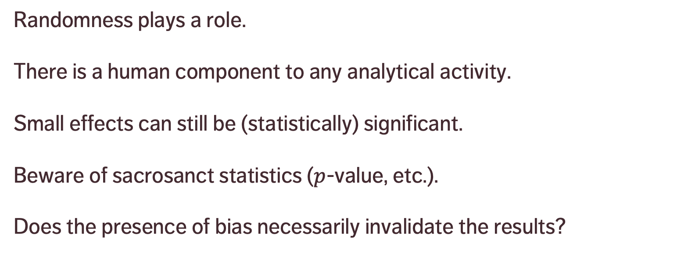
BIASES, FALLACIES & INTERPRETATION
Randomness plays a role.
There is a human component to any analytical activity.
Small effects can still be (statistically) significant.
Beware of sacrosanct statistics ($p$-value, etc.).
Does the presence of bias necessarily invalidate the results?

Slide 97
DATA SCIENCE MISTAKES
[A.K. Maheshwari, Business Intelligence and Data Mining]
Mistake #1 – Selecting the wrong problem.
Mistake #2 – Getting buried under tons of data without metadata understanding.
Mistake #3 – Not planning the data analysis process.
Mistake #4 – Insufficient business and domain knowledge.
Mistake #5 – Using incompatible data analysis tools.

Slide 98
DATA SCIENCE MISTAKES
[A.K. Maheshwari, Business Intelligence and Data Mining]
Mistake #6 – Using tools that are too specific.
Mistake #7 – Ignoring individual predictions/records in favour of aggregated results.
Mistake #8 – Running out of time.
Mistake #9 – Measuring results differently than the sponsor.
Mistake #10 – Naïvely believing what one’s told about the data.

Slide 99
WHAT WE DIDN’T TALK ABOUT
Tons of classification and clustering algorithms
Deep learning and neural networks
Recommender systems
Data streams
Bayesian data analysis
Text mining and natural language processing
Data engineering
… and so much more!

Slide 100
FUTURE TASKS
Self-driving vehicles
Machine translation and language understanding
Detection and prevention of climate and ecosystem disturbances
Automated data science (?!)
Detection and prevention of astronomical catastrophic events
Explainable A.I.

Slide 101
FUTURE TRENDS
New questions
New tools
New data sources
Data science as job component
Augmented/swarm intelligence

